Slide 1

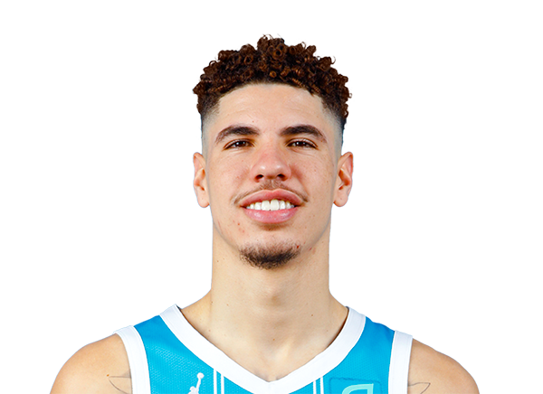

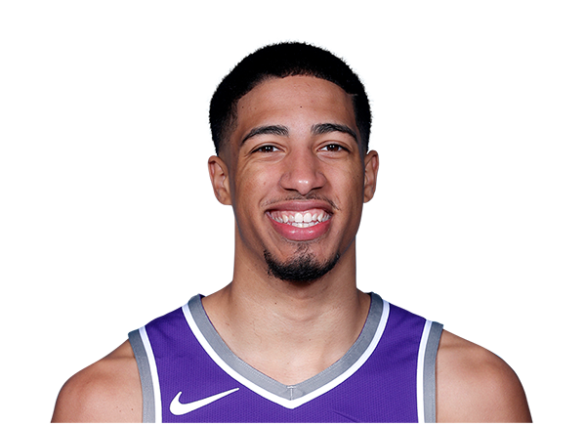
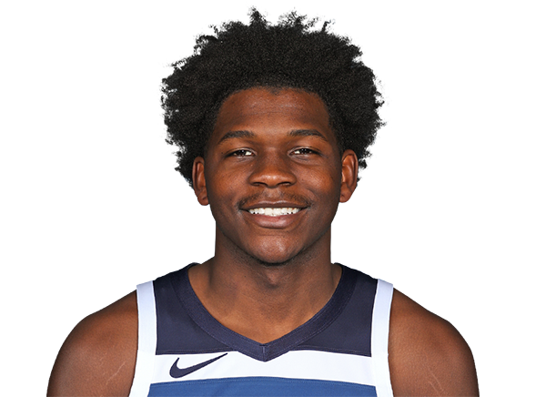
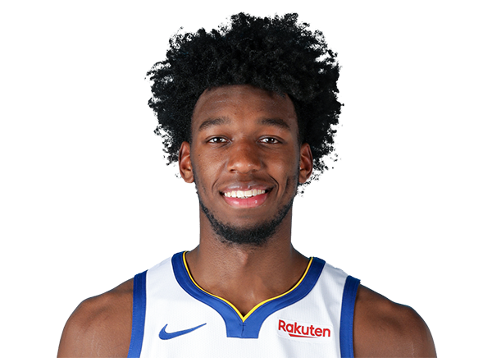
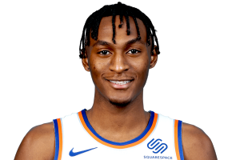
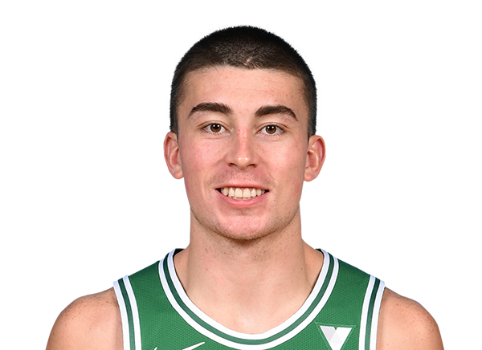
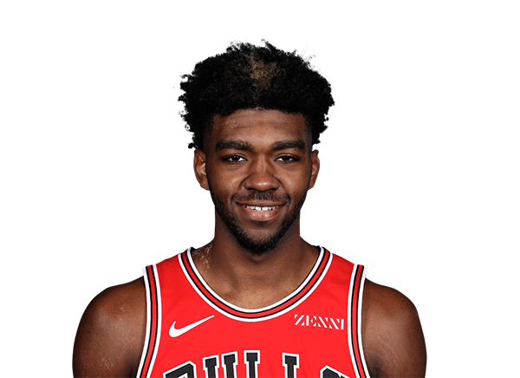
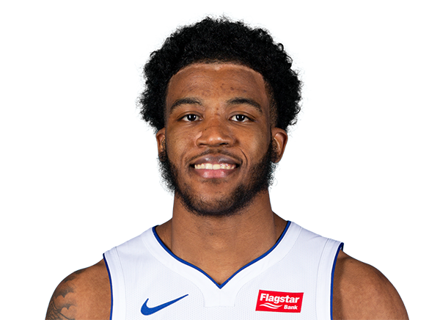
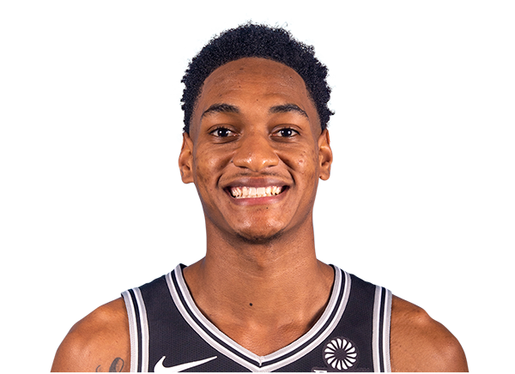
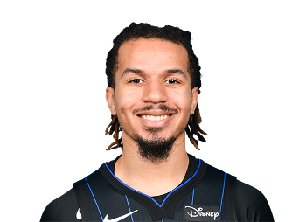
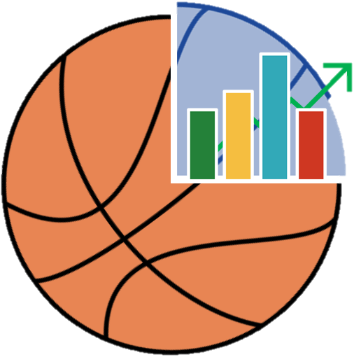
MY PERSONAL ROTY RANKINGS
Rank | Player
1 | LaMelo Ball (CHA)
2 | Tyrese Haliburton (SAC)
3 | Anthony Edwards (MIN)
4 | James Wiseman (GSW)
5 | Immanuel Quickley (NYK)
6 | Payton Pritchard (BOS)
7 | Patrick Williams (CHI)
8 | Saddiq Bey (DET)
9 | Devin Vassell (SAS)
10 | Cole Anthony (ORL)
NBA STAT PADDER

Slide 2
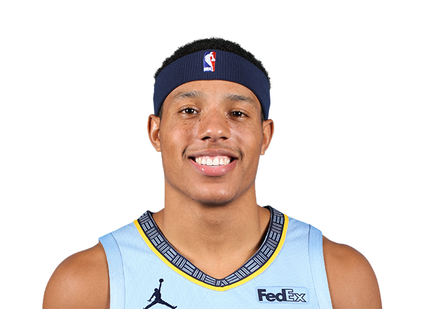
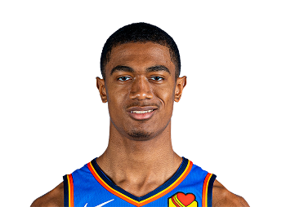
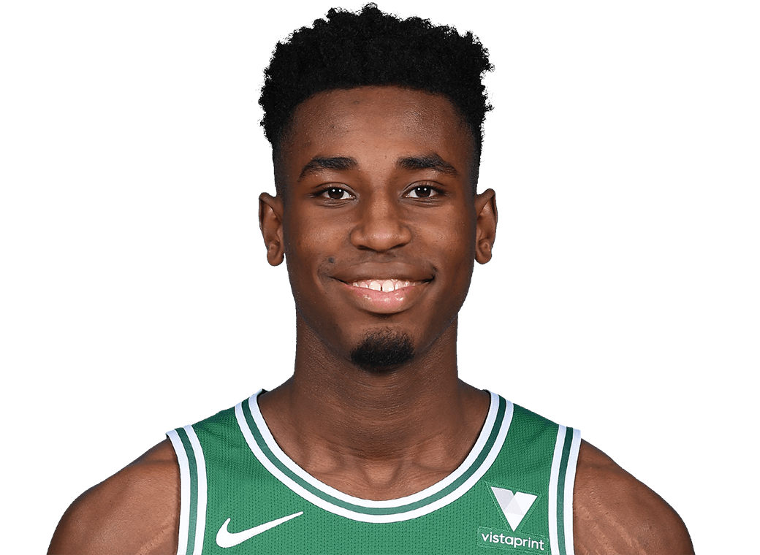
THROUGH FEBRUARY 17
Rank | Player | Score | % Chance to WIn
1 | Tyrese Haliburton (SAC) | 30.84 | 15.67%
2 | LaMelo Ball (CHA) | 27.16 | 13.82%
3 | Cole Anthony (ORL) | 23.97 | 12.19%
4 | Anthony Edwards (MIN) | 20.92 | 10.64%
5 | Desmond Bane (MEM) | 18.16 | 9.24%
6 | Theo Maledon (OKC) | 15.85 | 8.06%
7 | Aaron Nesmith (BOS) | 15.42 | 7.84%
8 | Payton Pritchard (BOS) | 15.22 | 7.74%
9 | Saddiq Bey (DET) | 14.86 | 7.56%
10 | James Wiseman (GSW) | 14.16 | 7.20%
NBA STAT PADDER

